Slide 1
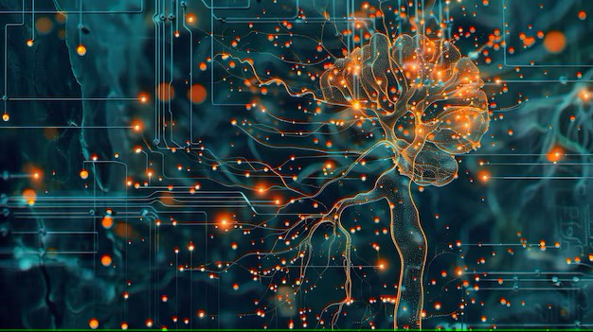



Week-8 (Discussion)
18th Mar, 2025
Deep Learning
Prof. Sudarshan Iyenger
Professor and Head of the Department
Department of Computer Science and Engineering
IIT Ropar
Ayan Paul
PMRF Research Scholar
IIT Kharagpur

Slide 2
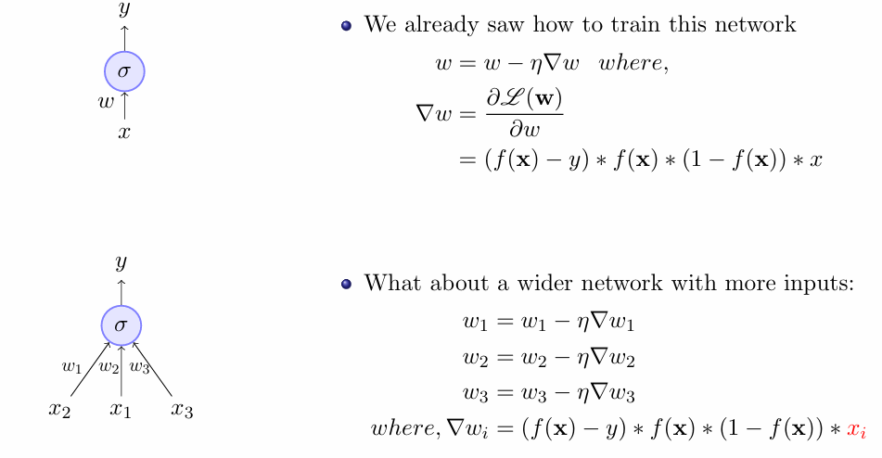
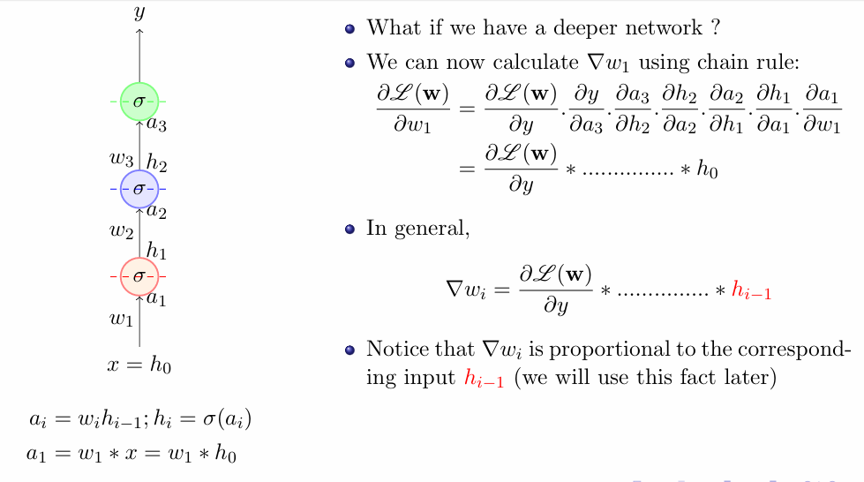
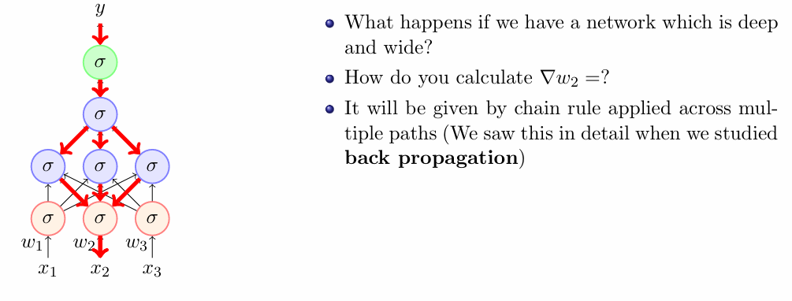
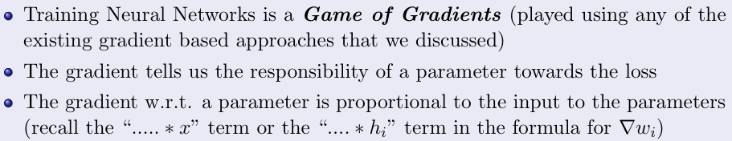
A quick recap of training deep neural networks
Small Network
Wide Network
Deep Network
Wide and Deep Network

Slide 3
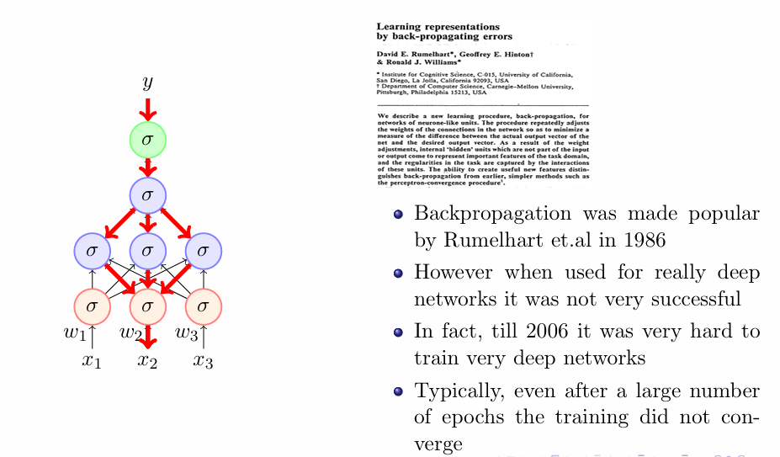
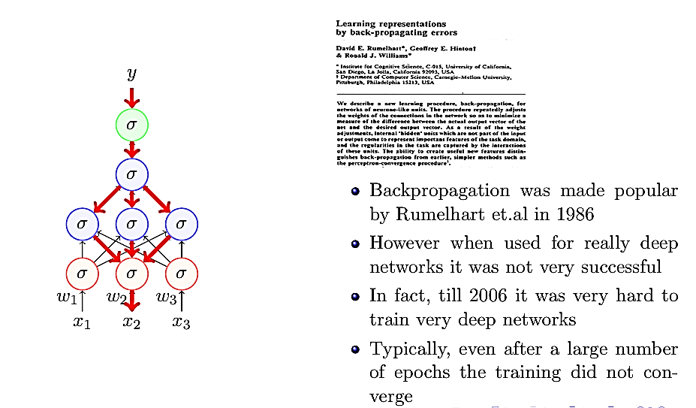
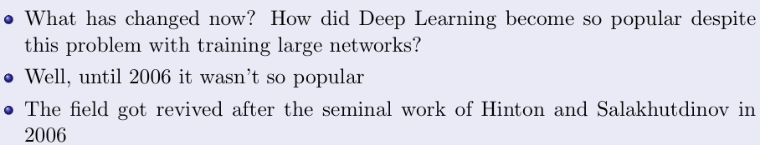
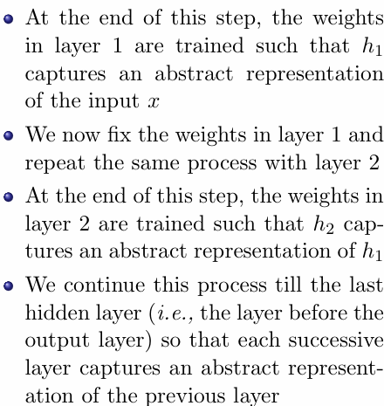
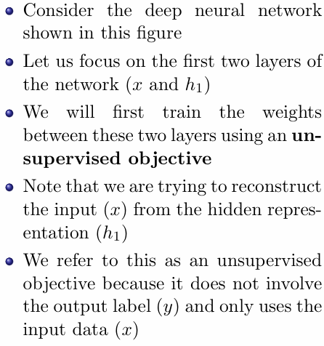
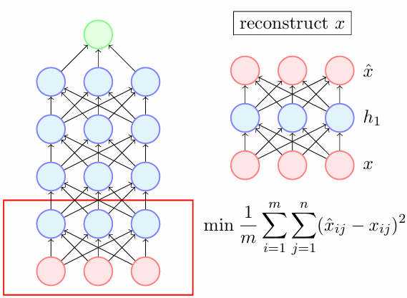
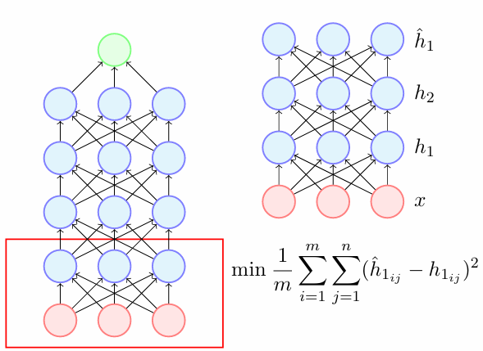
Limitation of Back Propagation
Unsupervised pre-training

Slide 4
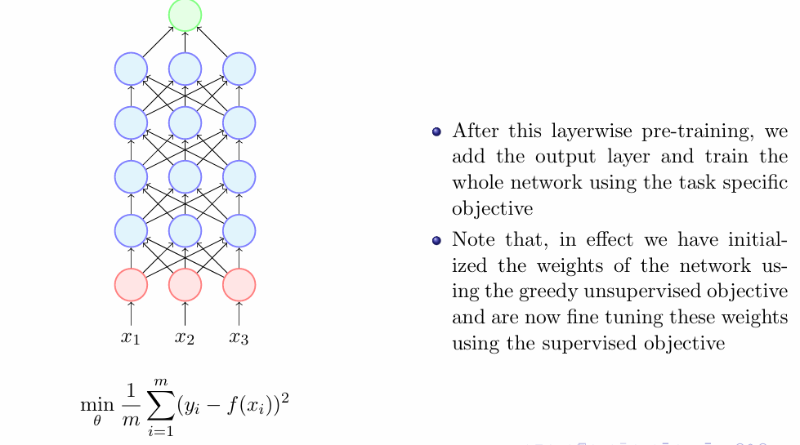
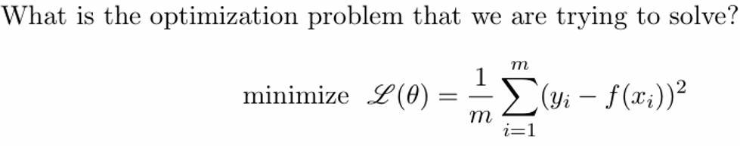
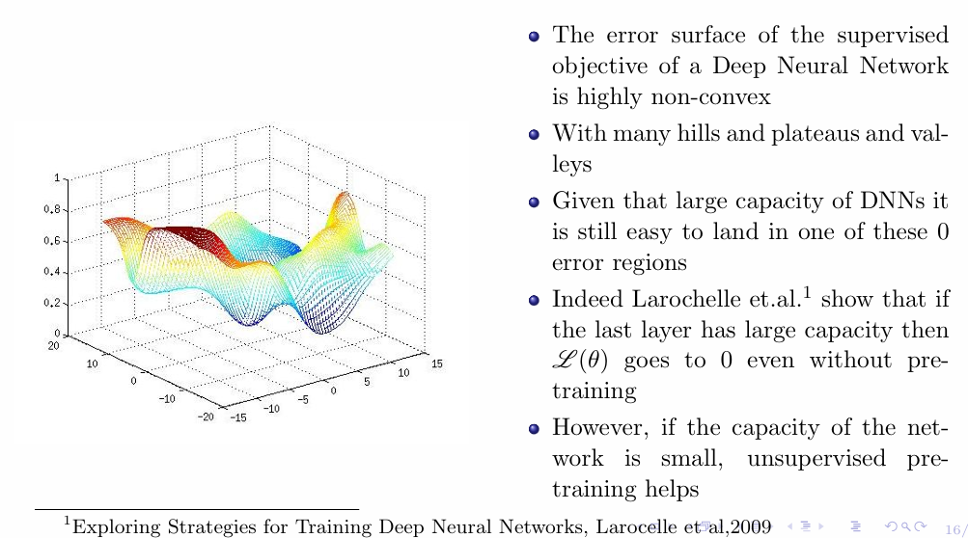
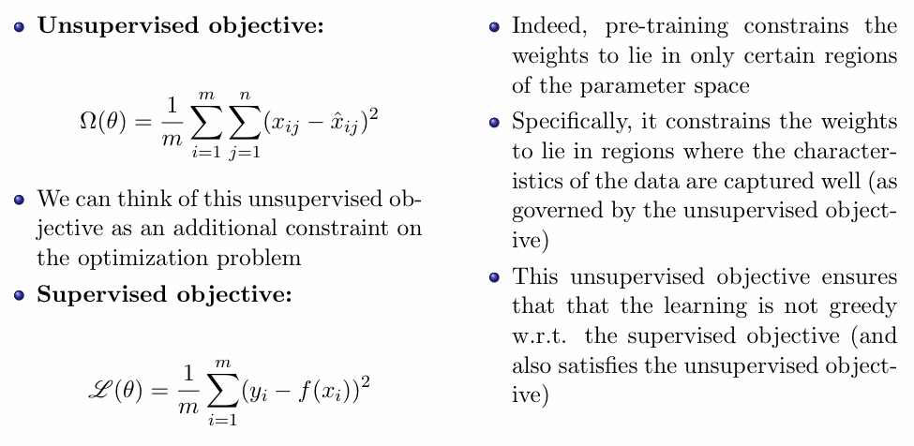
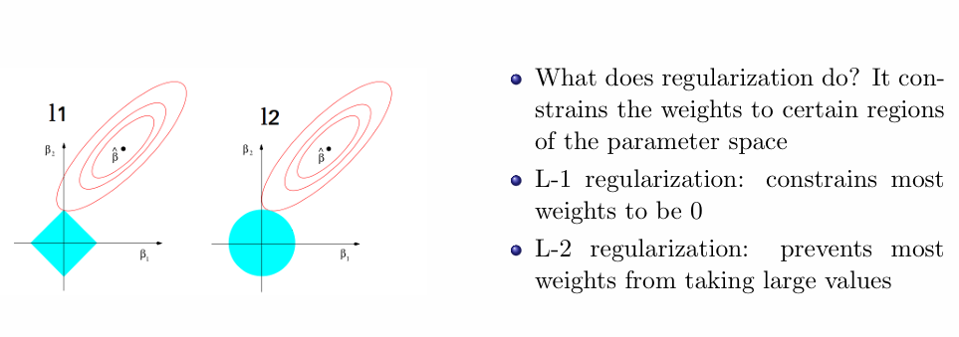
Why Unsupervised pre-training works
Better Optimization
Better Regularization

Slide 5
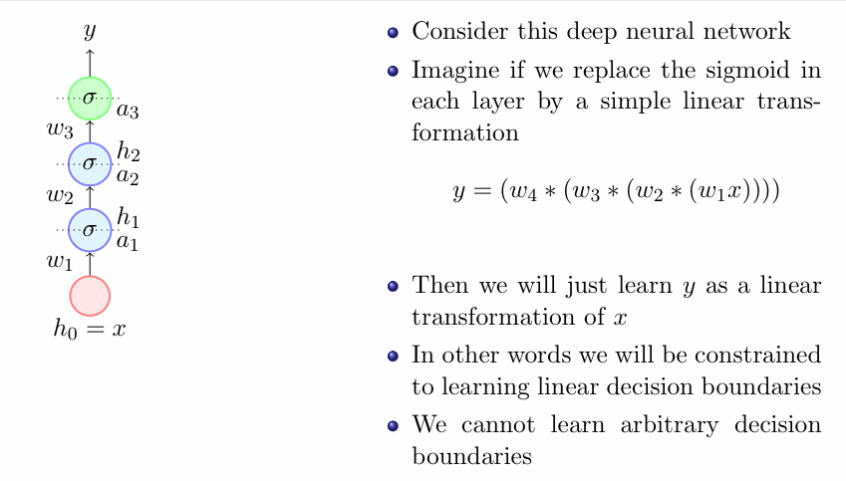
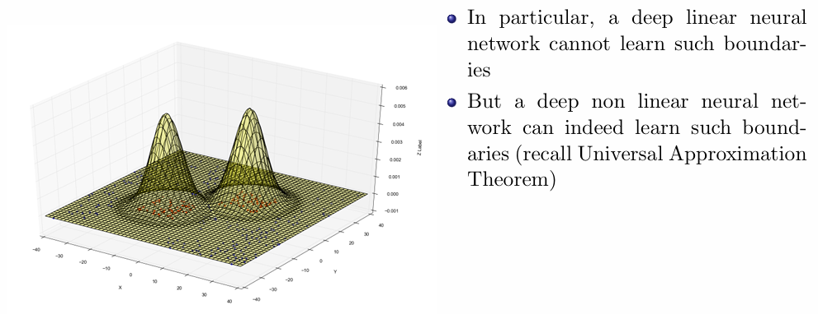
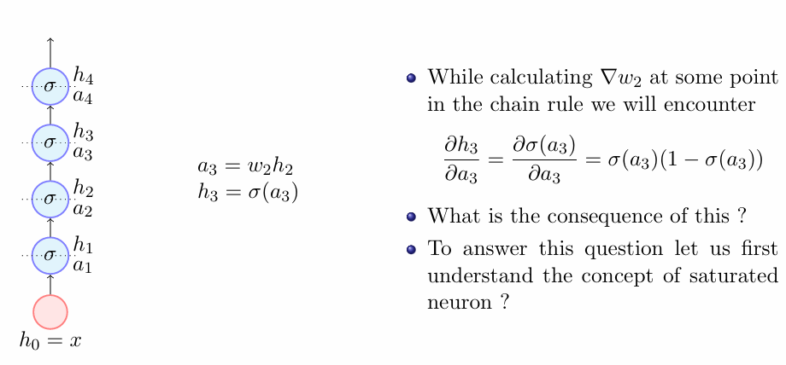
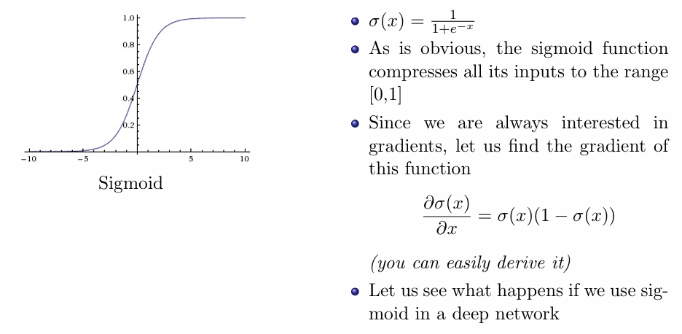
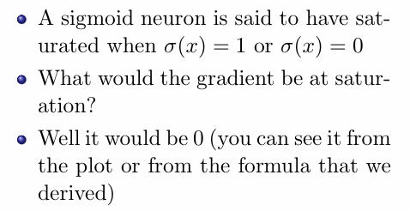
Linear Function
Better Activaion Functions
Limitations of linear function
Sigmoid Function

Slide 6
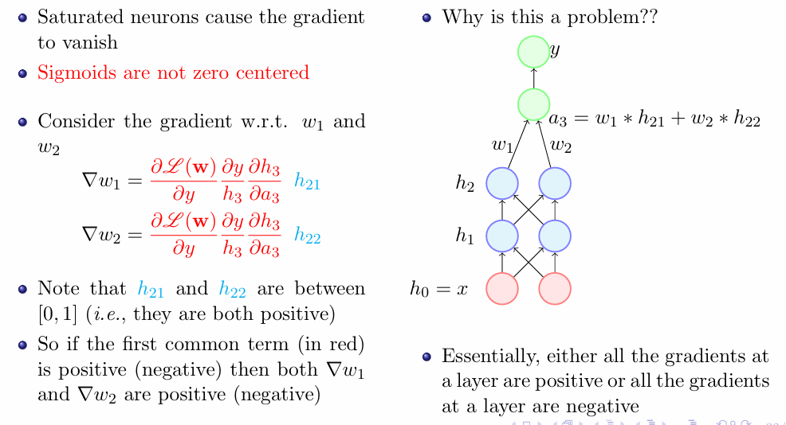
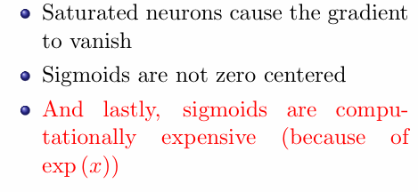
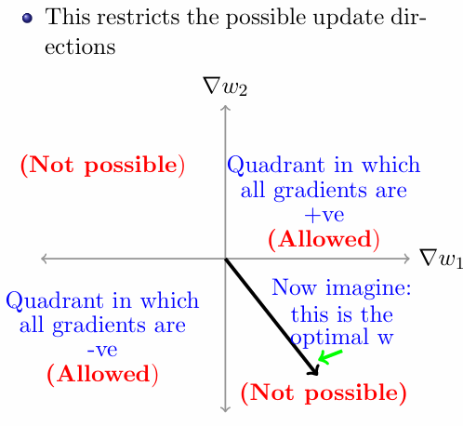
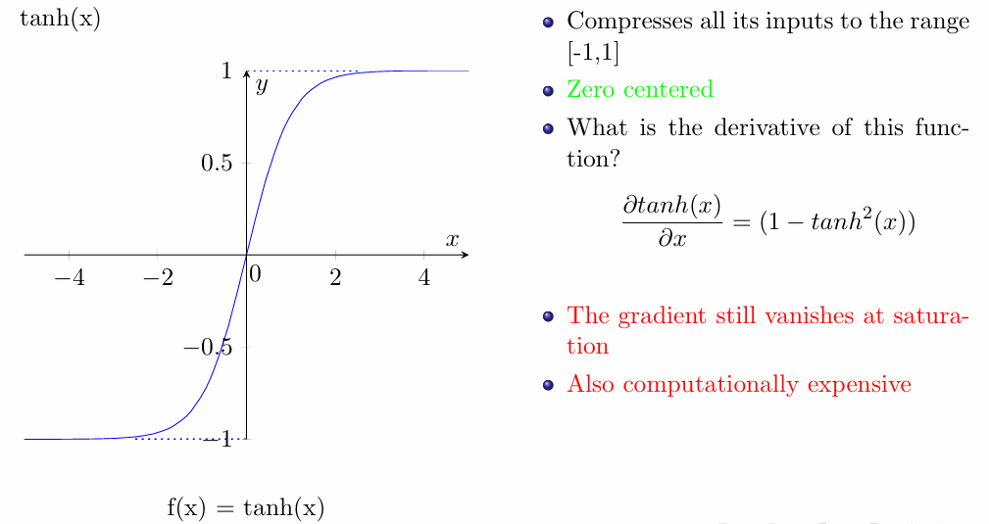
Limitations of sigmoid function
Limitations of tanh function
tanh Function

Slide 7
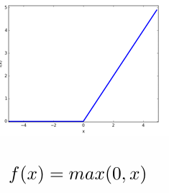
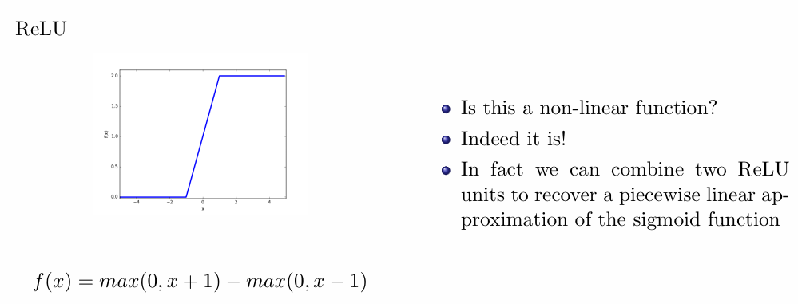
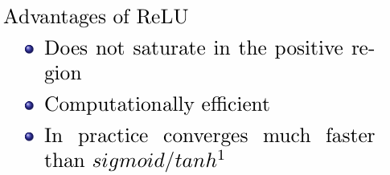
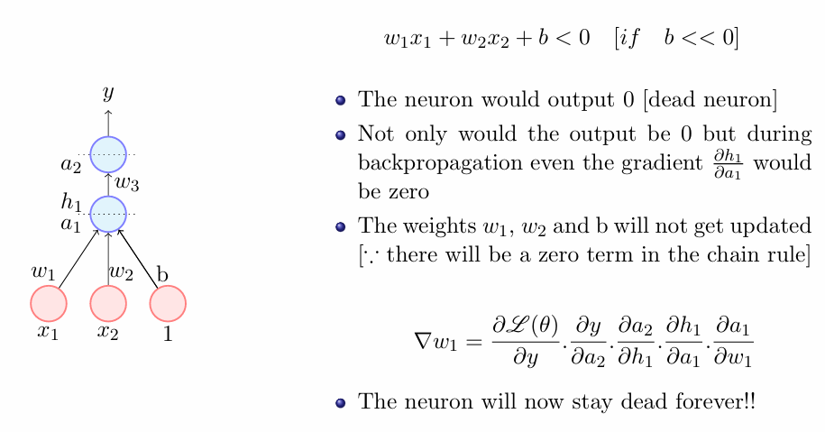
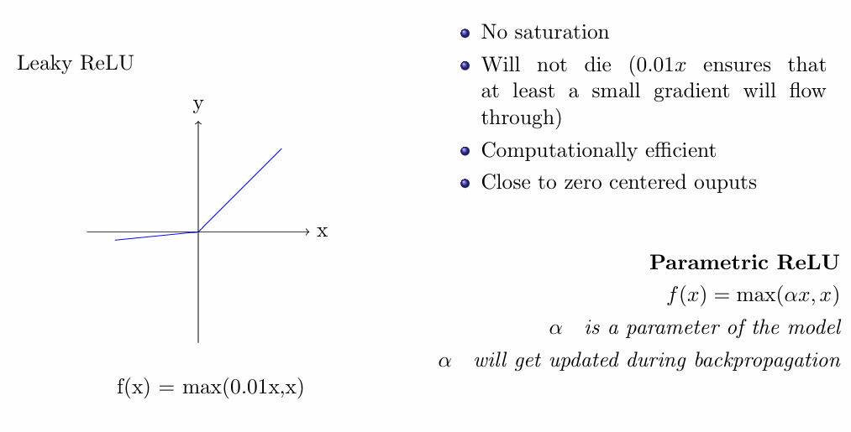
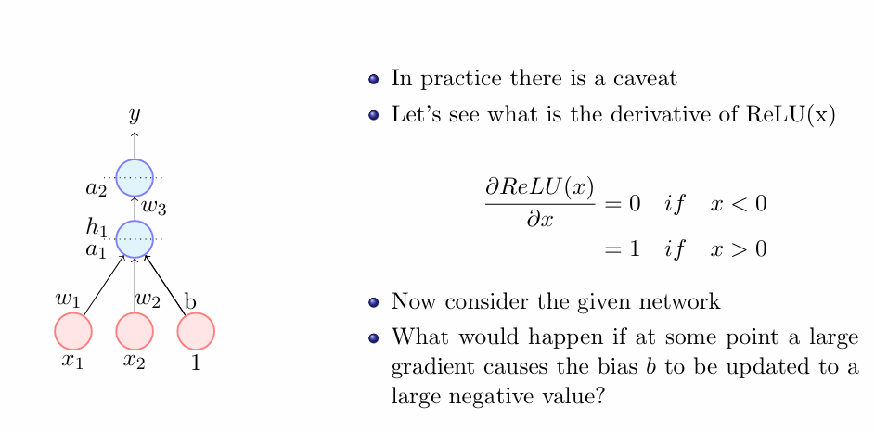
ReLU Function
Limitations of ReLU function
Leaky ReLU Function

Slide 8
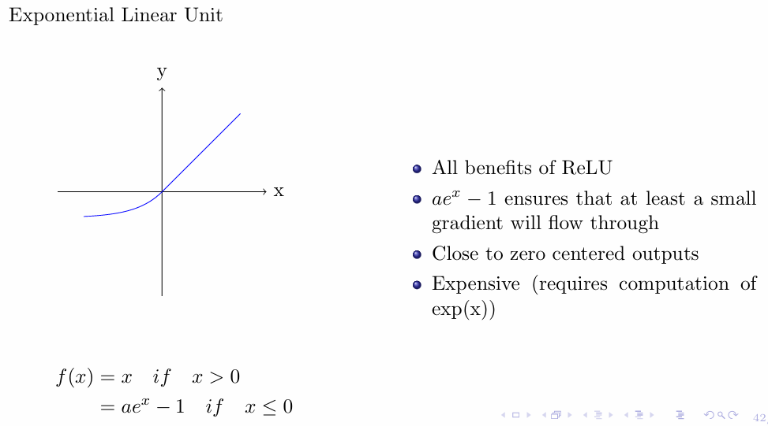
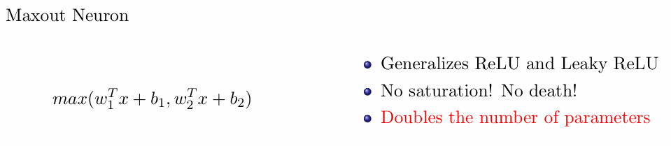
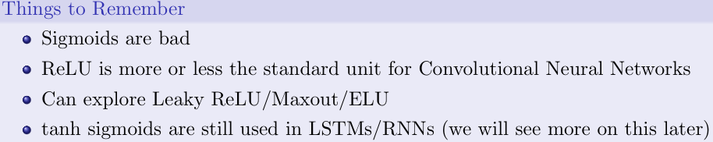
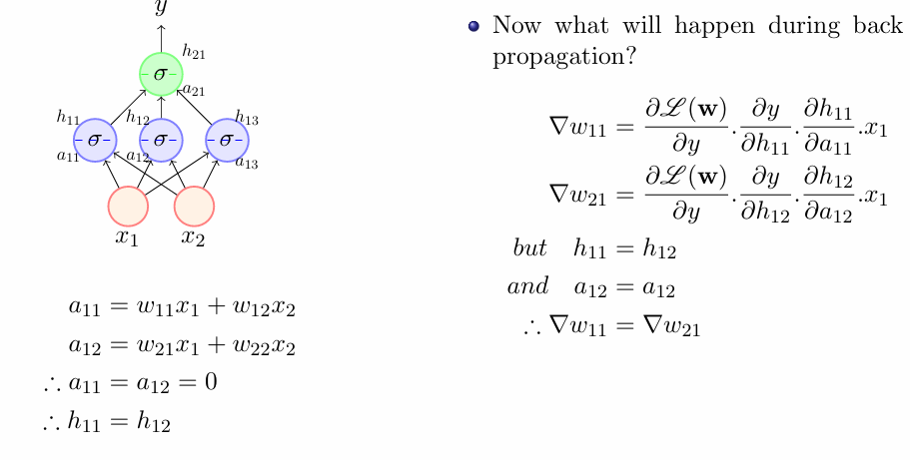
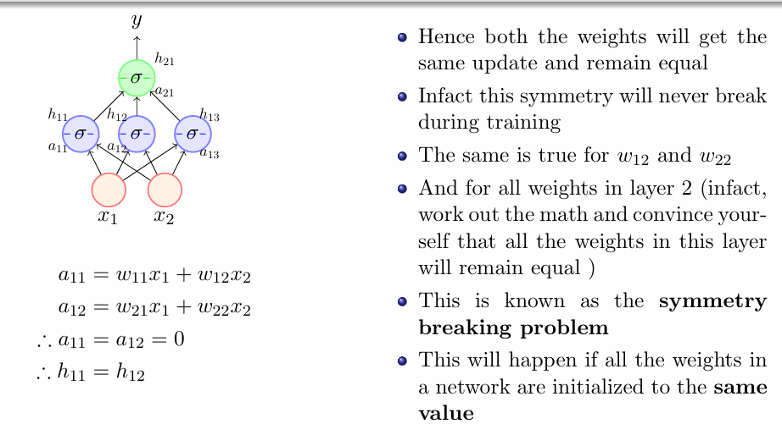
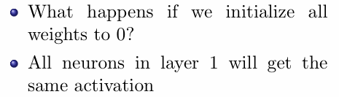
Exponential ReLU Function
Maxout Neuron
Better Initialization Strategies

Slide 9
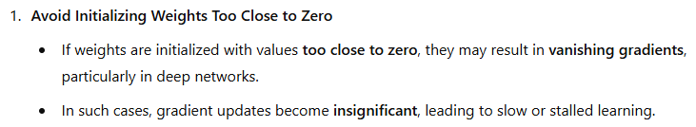
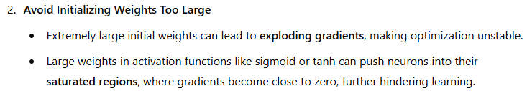
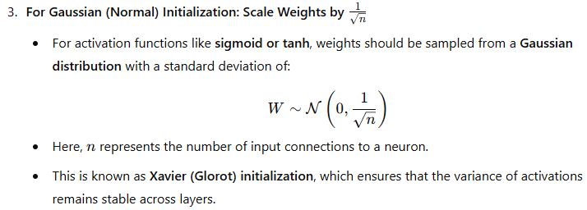
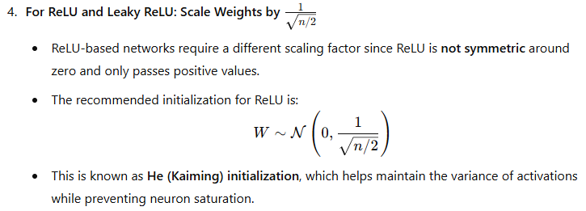
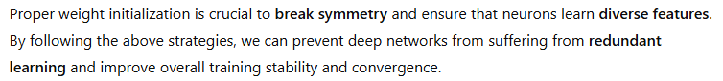
Solution of Symmetry breaking problem

Slide 10
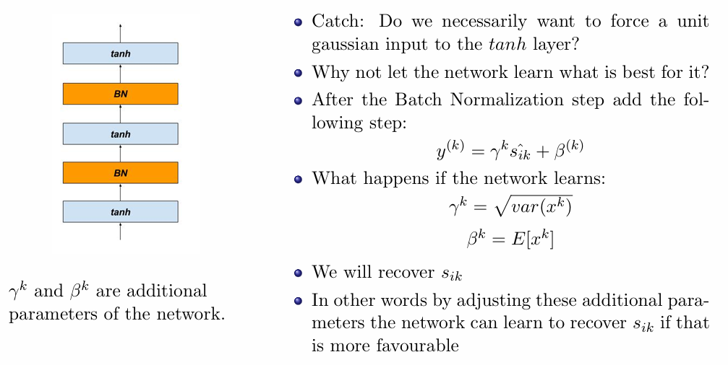
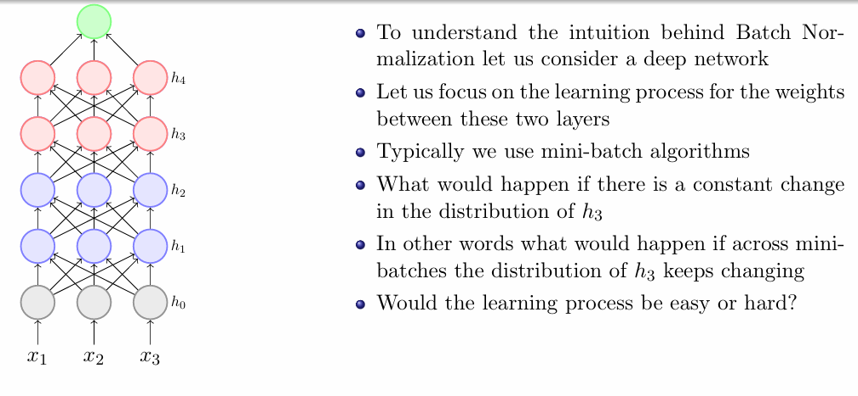
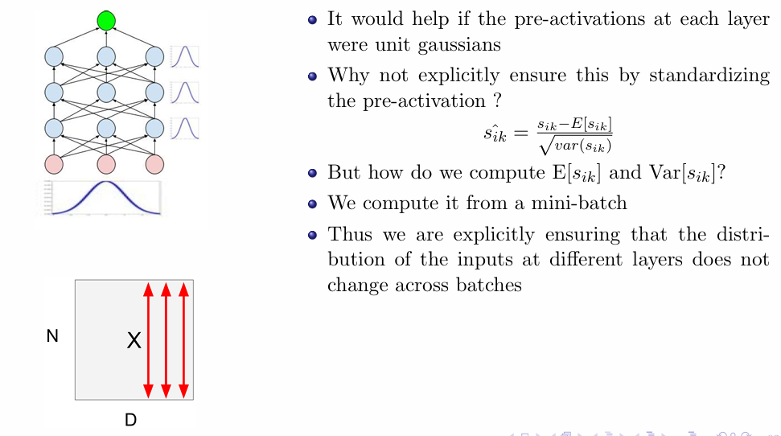
Batch Normalization

Slide 11
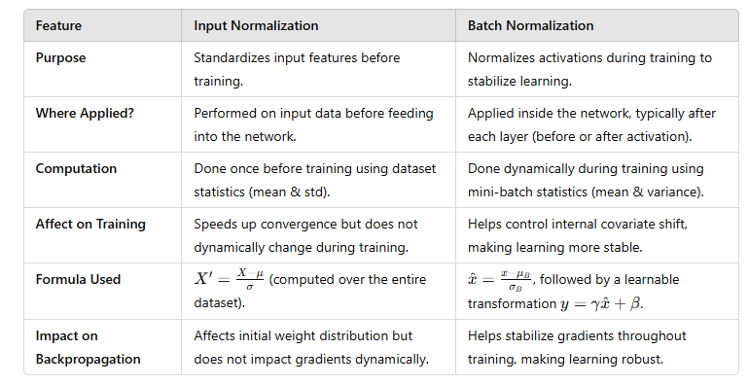
Input vs Batch Normalization

Slide 12
Topics on which Week 8 Assignment Questions are based
Training Deep Neural Network
Unsupervised Pre-Training
Better Activation Functions
Better Initialization Strategies
Batch Normalization

Slide 13
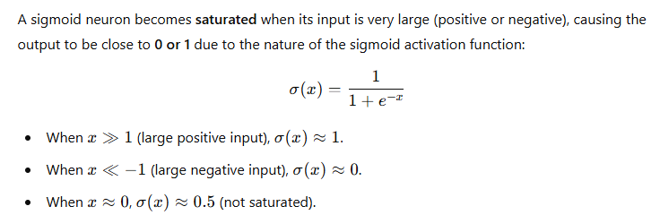
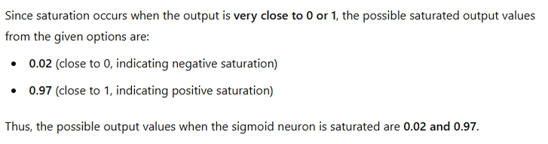
QUESTION 1
We have observed that the sigmoid neuron has become saturated. What might be the possible output values at this neuron?
0.02
0.5
1
0.97.
SOLUTION 1
CORRECT ANSWER 1
a), d)

Slide 14
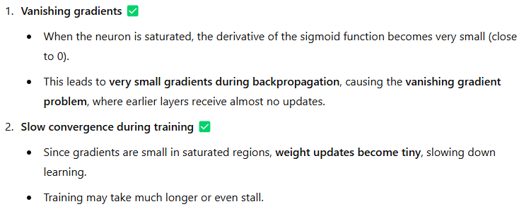

QUESTION 2
Which of the following are common issues caused by saturating neurons in deep networks?
Vanishing gradients
Slow convergence during training
Overfitting
Increased model complexity
SOLUTION 2
.
CORRECT ANSWER 2
a), b)

Slide 15



QUESTION 3
What are the challenges associated with using the Tanh(x) activation function?
It is not zero centered
Computationally expensive
Non-differentiable at 0
Saturation
SOLUTION 3
CORRECT ANSWER 3
b), d)

Slide 16



QUESTION 4
SOLUTION 4
CORRECT ANSWER 4
0.05

Slide 17


QUESTION 5
How does pre-training prevent overfitting in deep networks?
It adds regularization
It initializes the weights near local minima
It constrains the weights to a certain region
It eliminates the need for fine-tuning
SOLUTION 5
CORRECT ANSWER 5
a), c)

Slide 18


QUESTION 6
We train a feed-forward neural network and notice that all the weights for a particular neuron are equal. What could be the possible causes of this issue?
Weights were initialized randomly
Weights were initialized to high values
Weights were initialized to equal values
Weights were initialized to zero
SOLUTION 6
CORRECT ANSWER 6
c), d)

Slide 19


QUESTION 7
Which of the following is true about the role of unsupervised pre-training in deep learning?
It is used to replace the need for labeled data
It is used to initialize the weights of a deep neural network
It is used to fine-tune a pre-trained model
It is only useful for small datasets
SOLUTION 7
CORRECT ANSWER 7
b)

Slide 20


QUESTION 8
Which of the following is an advantage of unsupervised pre-training in deep learning?
It helps in reducing overfitting
Pre-trained models converge faster
It improves the accuracy of the model
It requires fewer computational resources
SOLUTION 8
CORRECT ANSWER 8
a), b), c)

Slide 21


QUESTION 9
What is the main cause of the Dead ReLU problem in deep learning?
High variance
High negative bias
Overfitting
Underfitting
SOLUTION 9
CORRECT ANSWER 9
b)

Slide 22



QUESTION 10
What is the main cause of the symmetry breaking problem in deep learning?
High variance
High bias
Overfitting
Equal initialization of weights
SOLUTION 10
CORRECT ANSWER 10
d)

